Slide 1
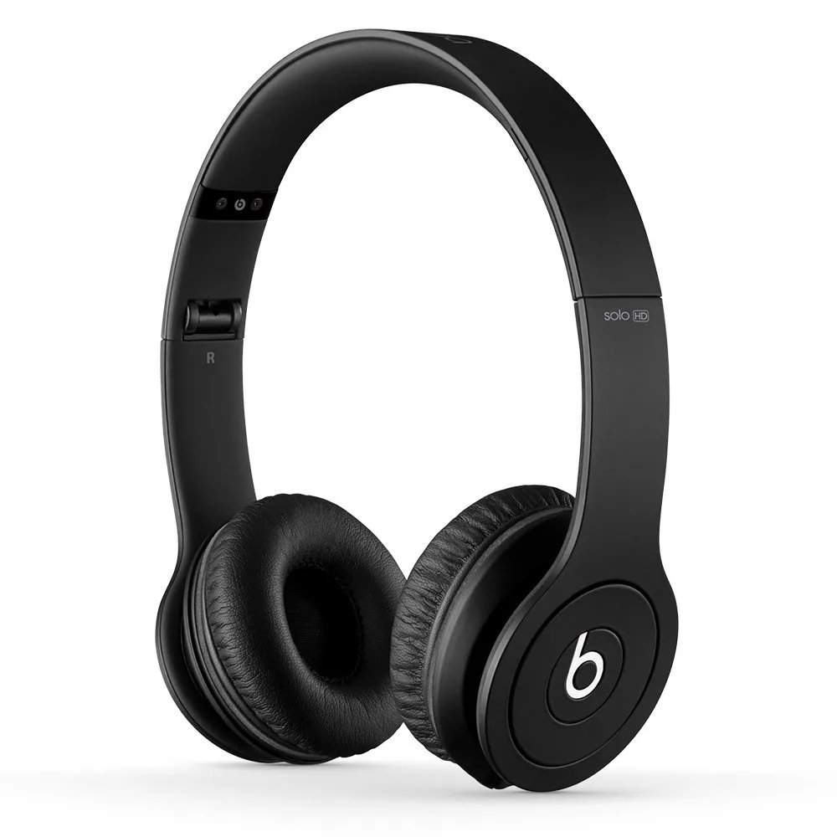
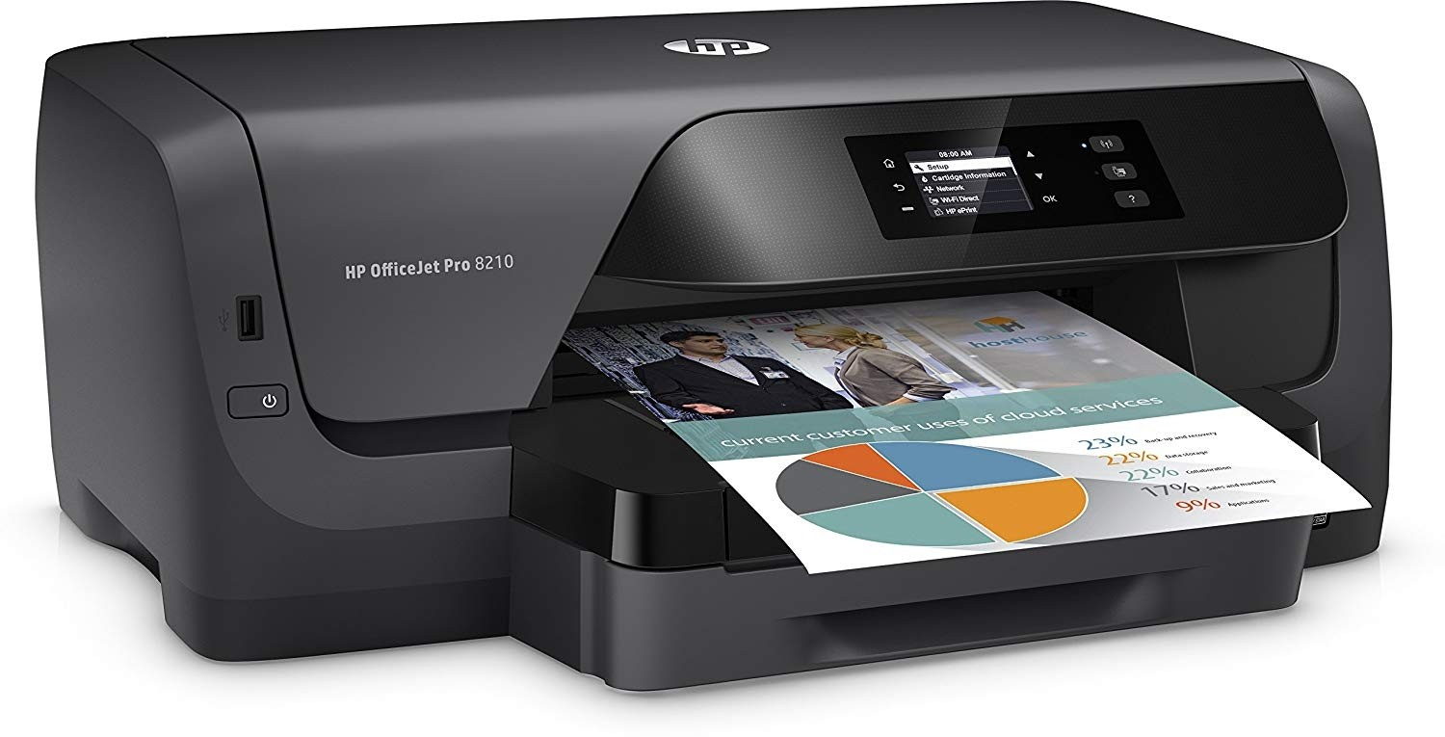
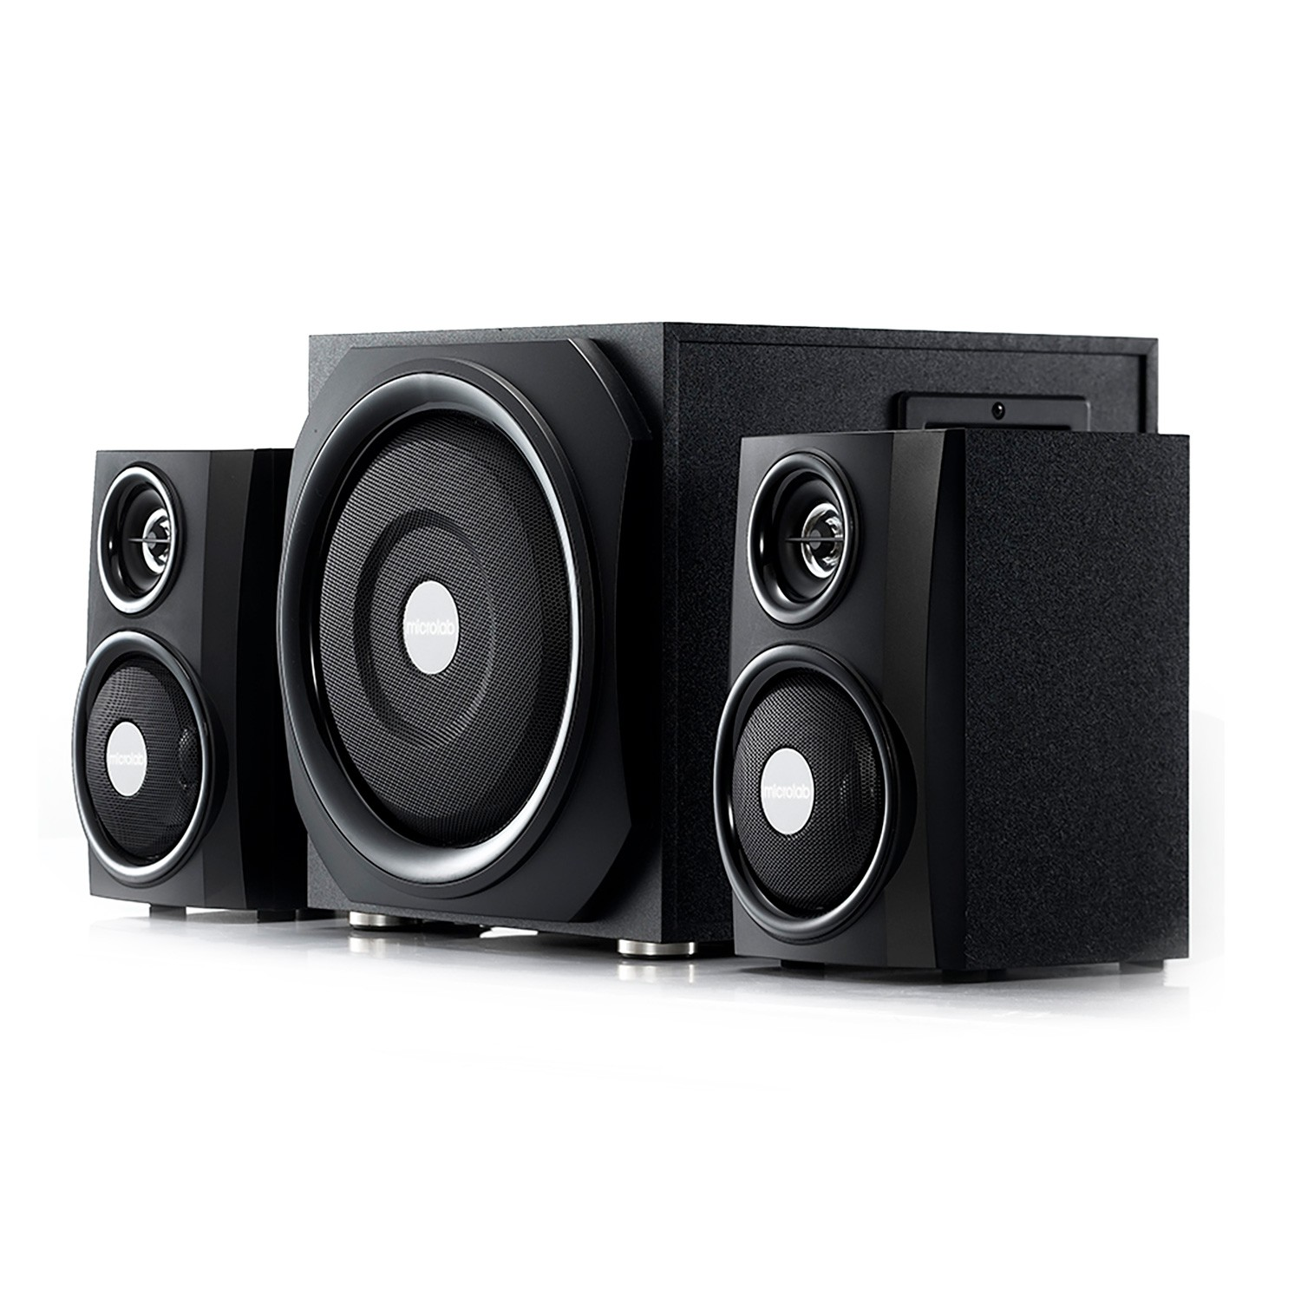
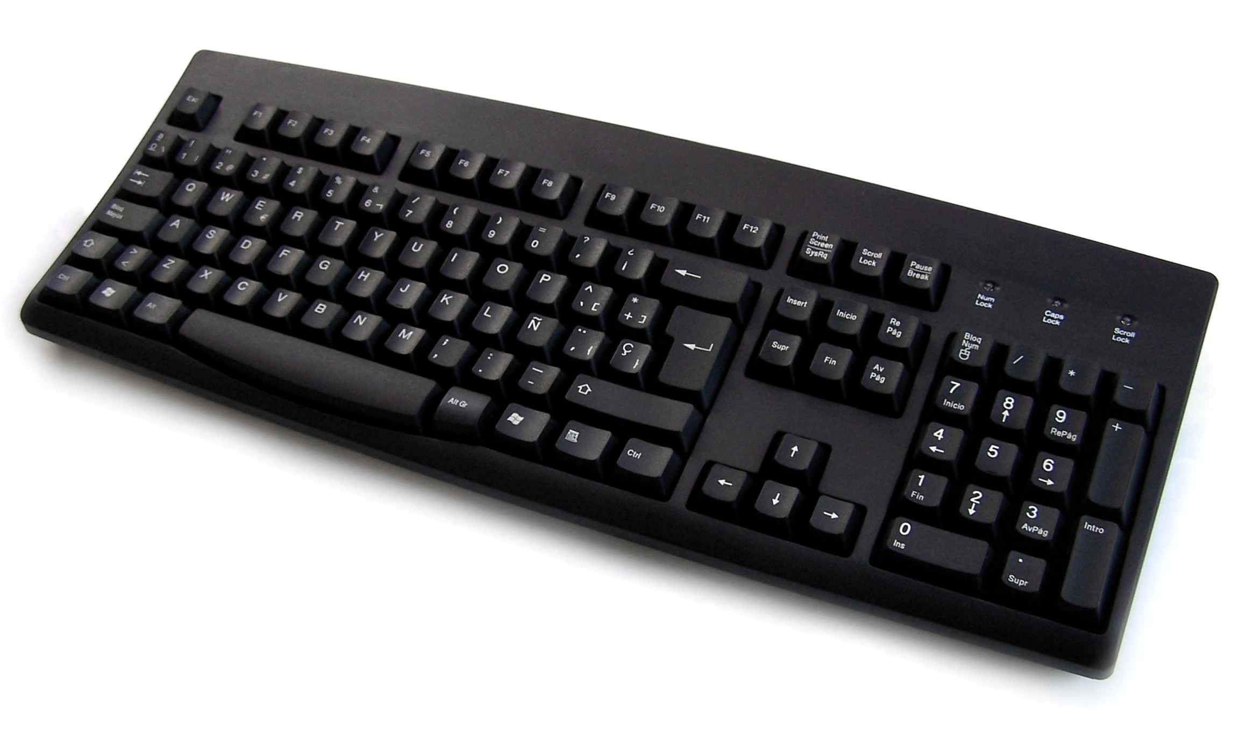
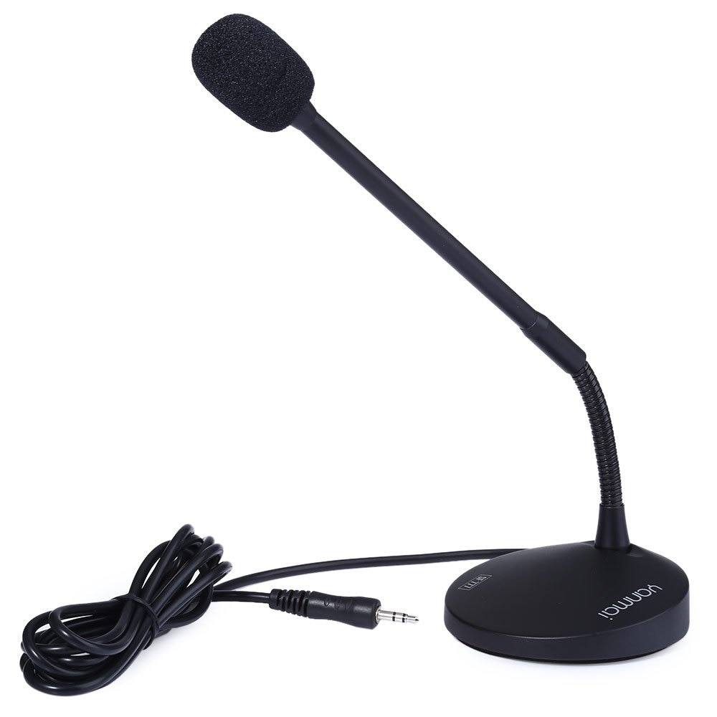



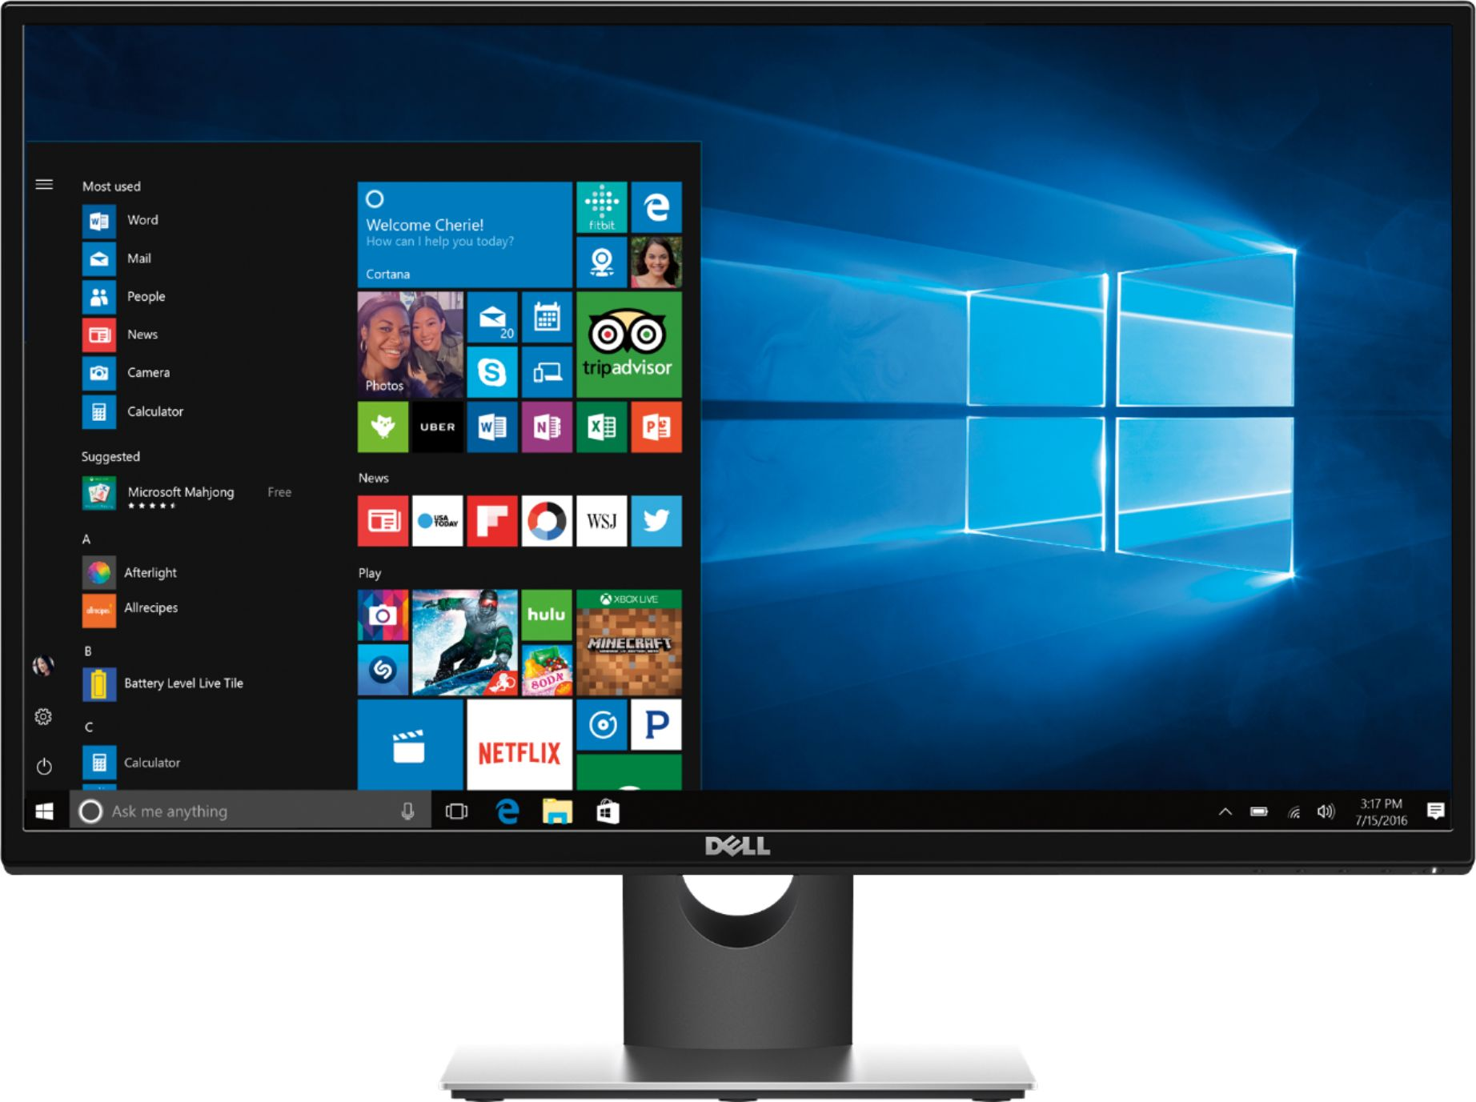

Challenge 1: Can you drag the images to show whether they are input or output devices? If you think they are BOTH, leave them in the middle.
Input?
Both?
Output?

Slide 2
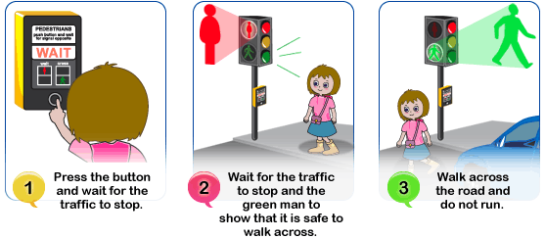
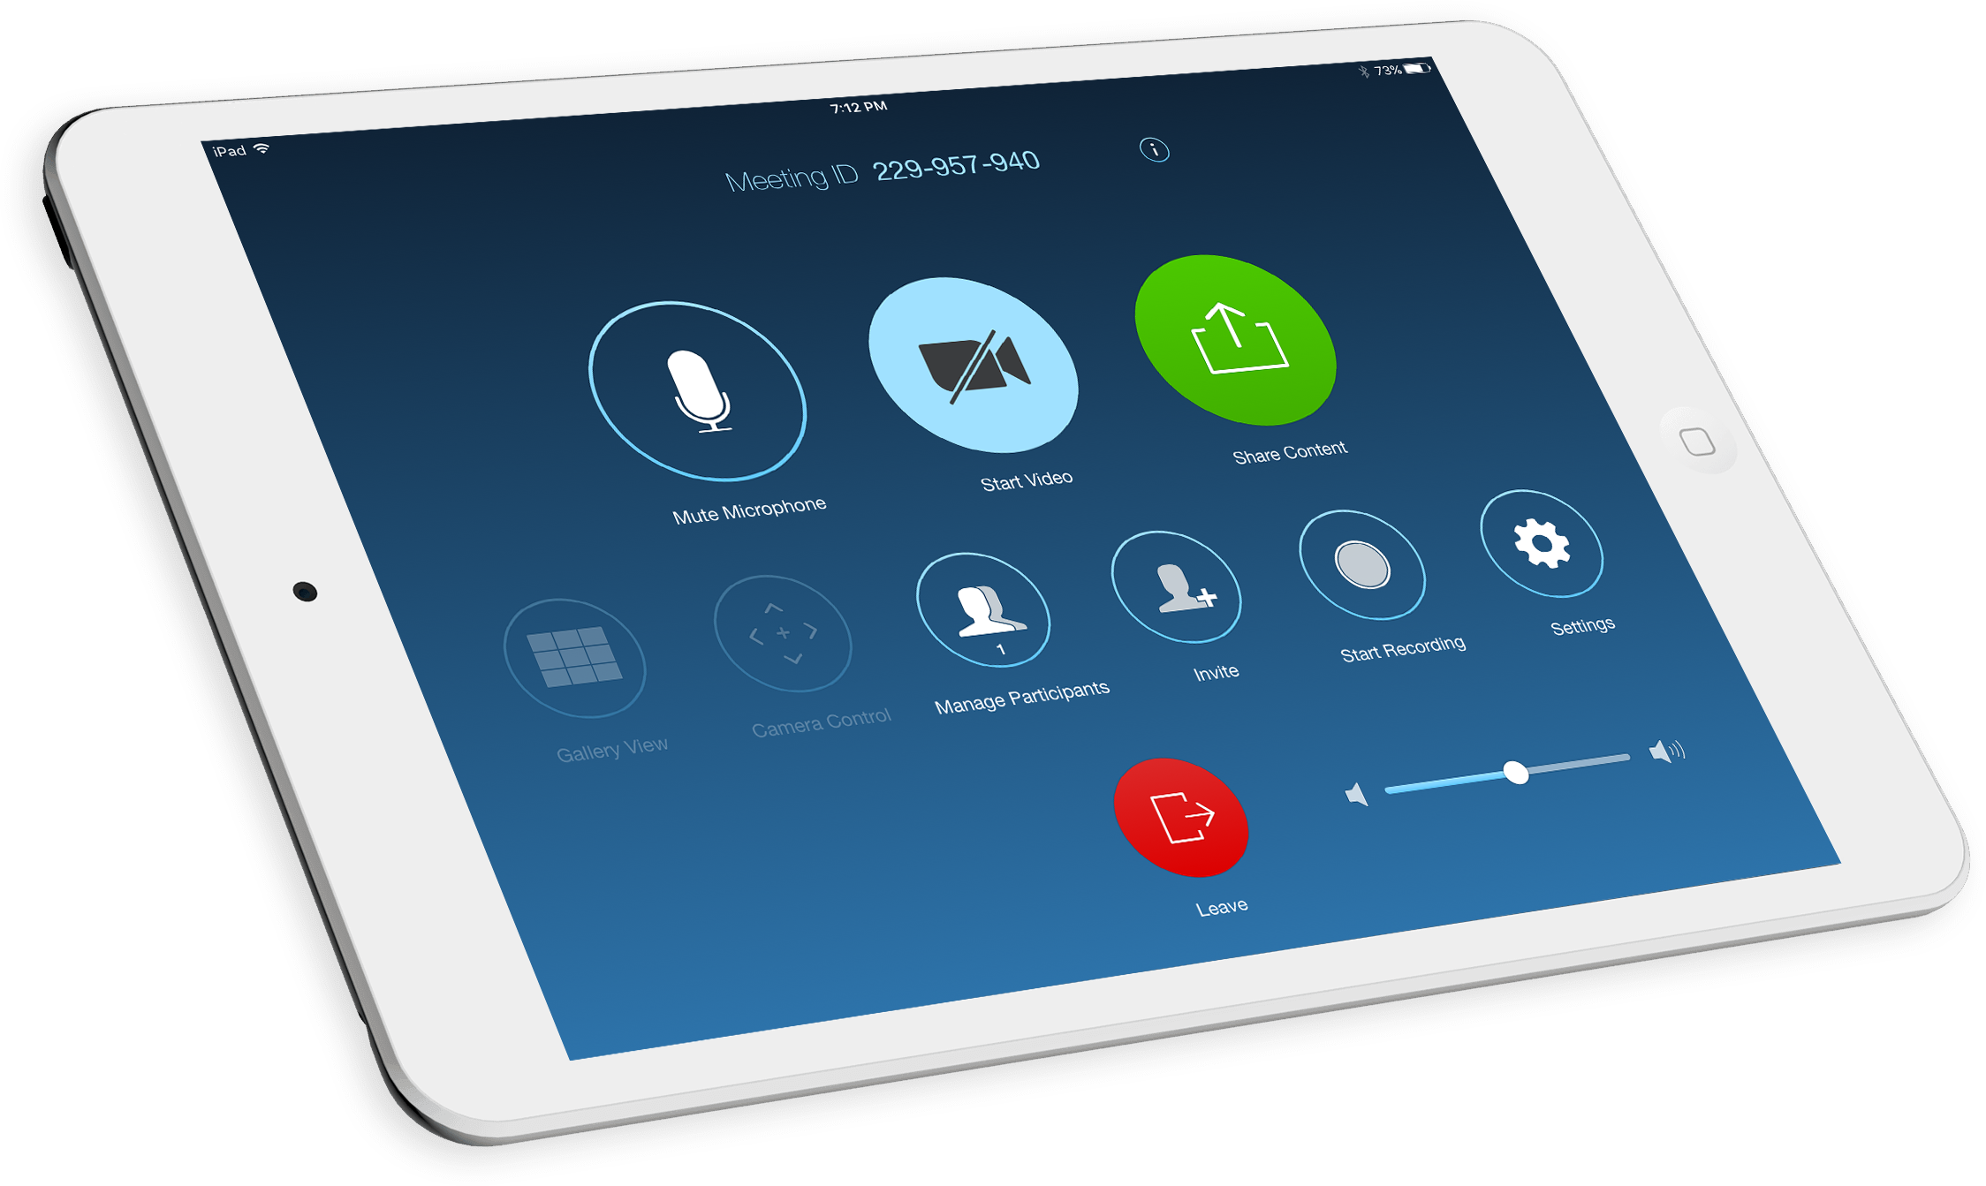
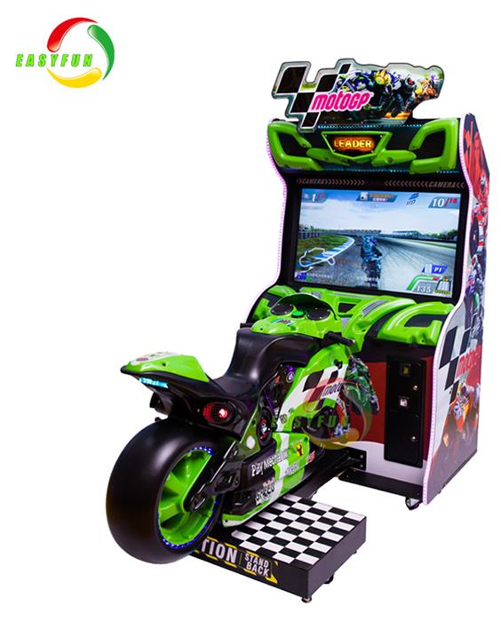
Challenge 2: Can you identify the input and output devices in these computer systems?
What are the inputs and outputs of this crossing?
The input is...
The outputs are...
What are the inputs and outputs of this tablet device?
What are the inputs and outputs of this motorbike arcade ride ?
The inputs are...
The outputs are...
The inputs are...
The outputs are...

Slide 3
Challenge 3: Can you find an image of a computer system you have used before and explain the input and outputs it uses? Example systems might a games console, your favourite computerised toy, a smart device you have in your house like security cameras/alarms.
Use Swiggle or Insert > Pictures > Online Pictures to locate an image to copy and paste it below.
I have chosen a…
It works by...

Slide 4
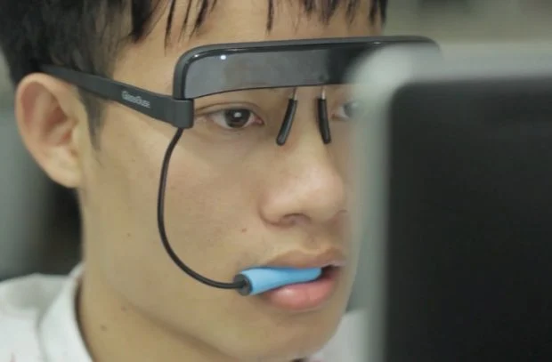
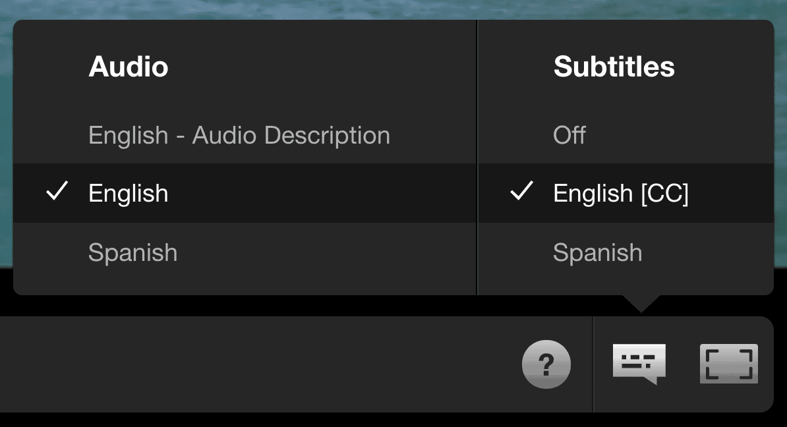
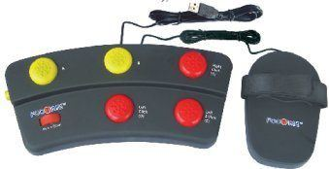


Assistive technologies
Extension 1: Can you find some input or output devices that would help these computer users who have different physical needs? Watch this video from 1minute 54seconds onwards (https://www.bbc.co.uk/teach/class-clips-video/computing-ks2-input-output/zf3fp4j) and also use Swiggle/Kidrex to research assistive input and outputs.
Physical need | Suggested devices and reasons
The computer user is severely vision impaired and has no sight
The computer user is unable to use either of their hands to control a mouse
The computer user is unable to hear, so finds watching videos difficult

