Slide 1
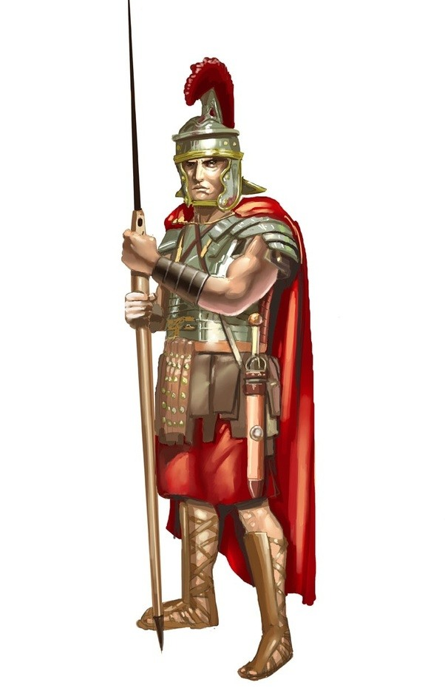
The Roman Empire
Would you like to learn about the Romans?
HOME
TIMELINE
DAILY LIFE
ROMAN ARMY
INVENTIONS
Welcome message will go here
Map of the Empire will go here
Interesting facts about Romans will go here
Links to other useful websites here

